Slide 1

Gain and Phase Analyzer
May 8, 2015
Notes:
C

Slide 2

Team
Chris Pavlina
Electrical Engineer, Team Lead
Harrison Owens
Computer Engineer
Ken Zach
Computer Engineer
Kyle Temkin
Faculty Advisor
Notes:
C

Slide 3
Agenda
Purpose
Requirements
Design
PCB
GUI
Schedule
Budget
Final Steps
Notes:
H

Slide 4
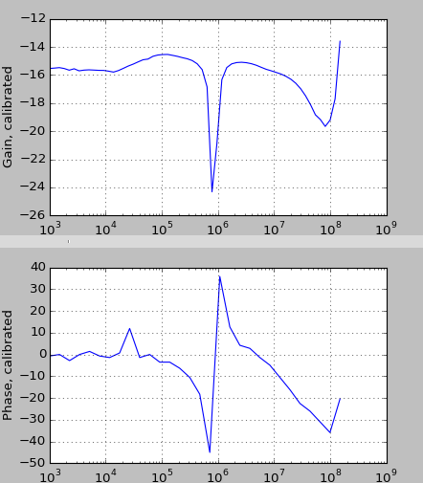
Purpose
Test the performance of filters, amplifiers
Generate Bode plot with
amplitude and phase
Notes:
K

Slide 5

Uses
Education
Testing, design, characterization of:
Signal filters
Signal amplifiers
Control systems
Notes:
K

Slide 6
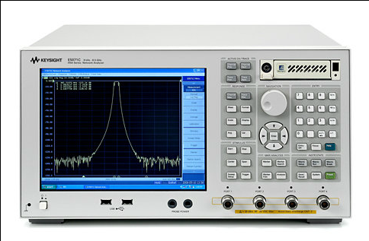
Why?
Current state of industry
Large
Expensive
Learning curve
Students can’t see how it works!
Our Goal
Portable
Cost around $200
Easy to use for students and teachers
Open source
Image: Keysight Technologies, “E5071C ENA Series Network Analyzer”
Notes:
Chris

Slide 7
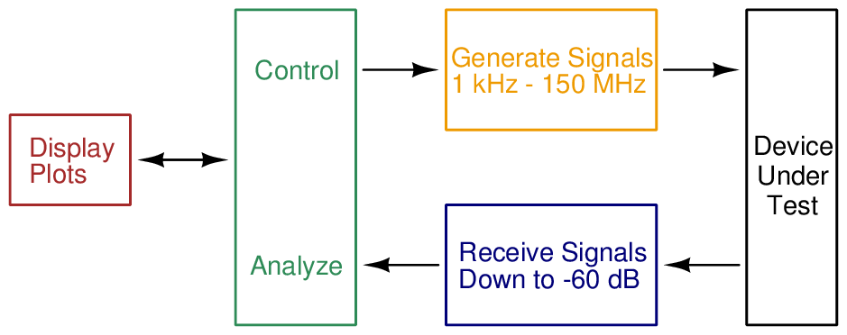
Requirements
Notes:
Chris

Slide 8
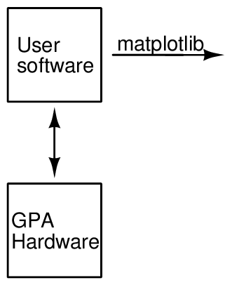
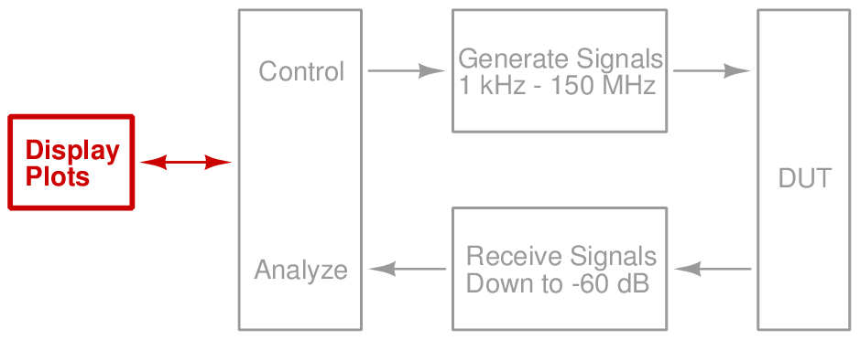
Design Software
Notes:
Harrison

Slide 9
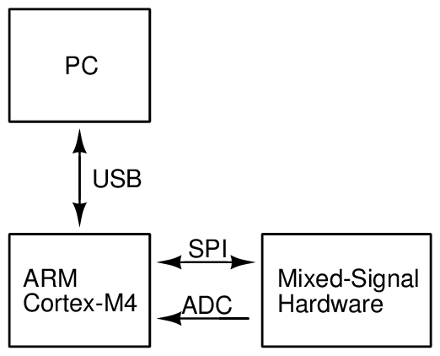
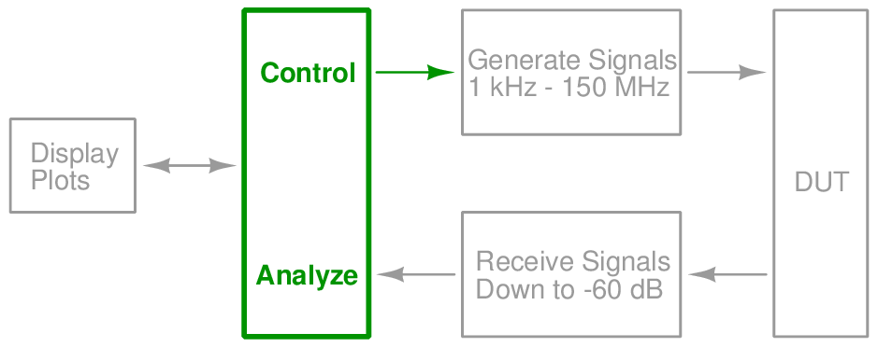
Design Microcontroller
SAM4S Development Board
Notes:
Harrison

Slide 10
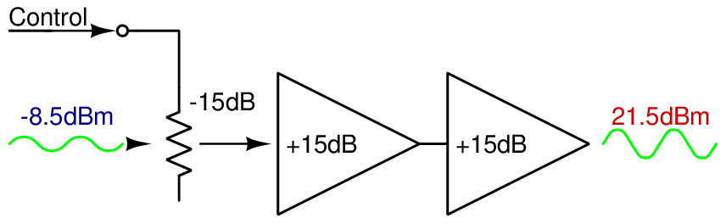
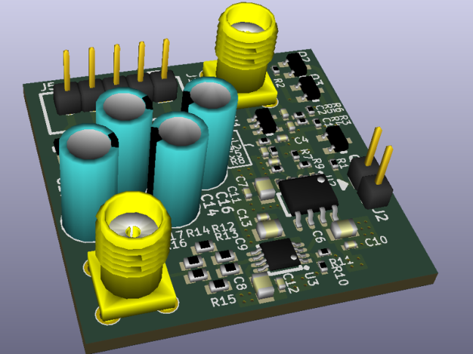
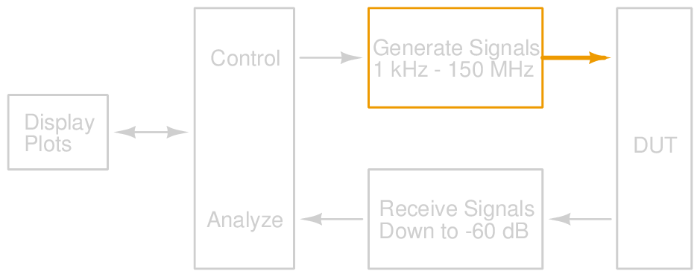
Design Signal Output
Notes:
C

Slide 11
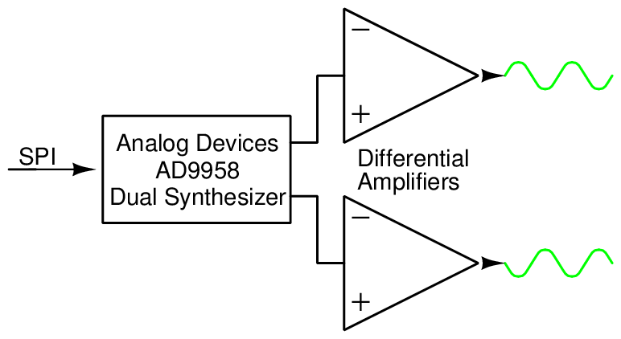
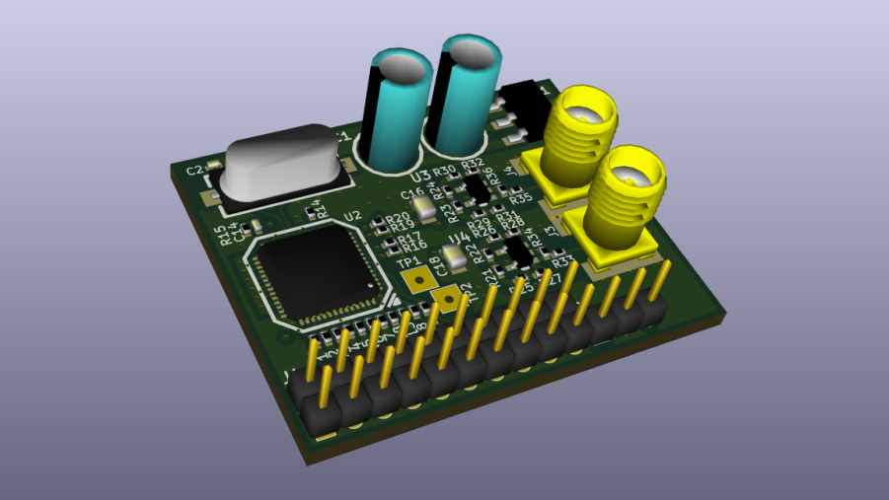
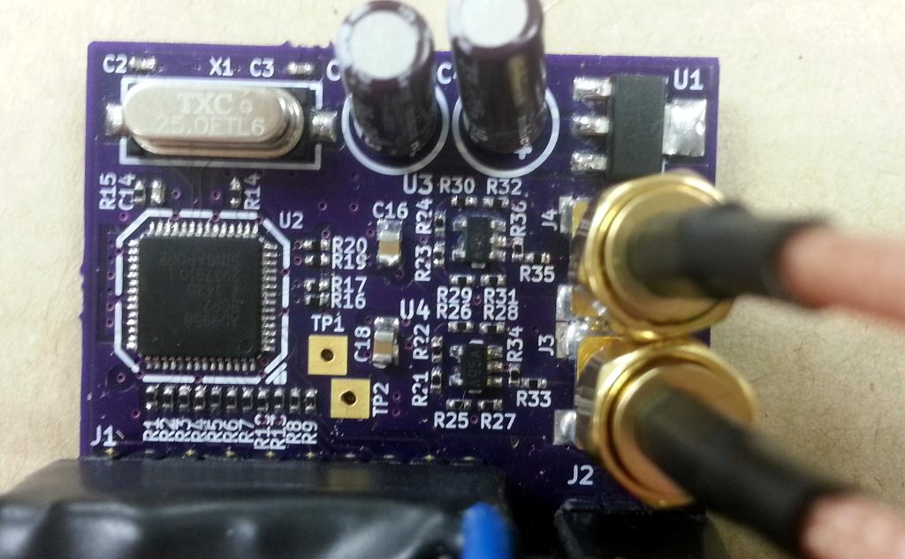
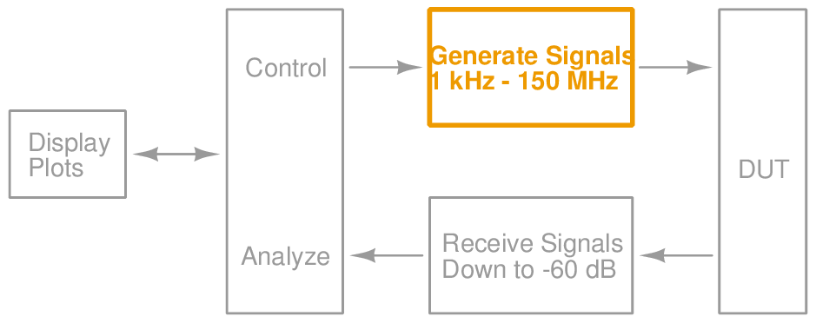
Design Signal Generation
Notes:
Ken

Slide 12
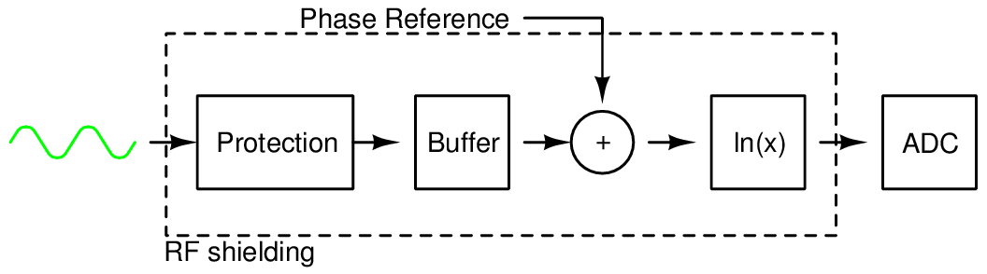
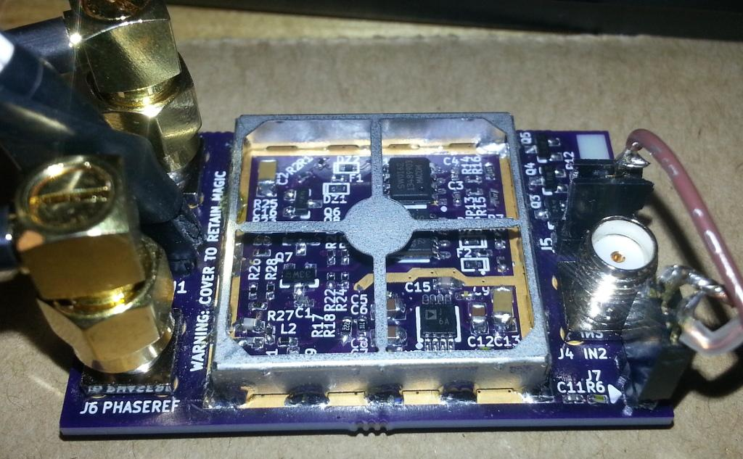
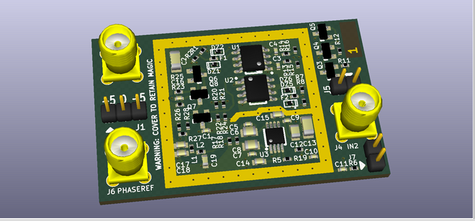
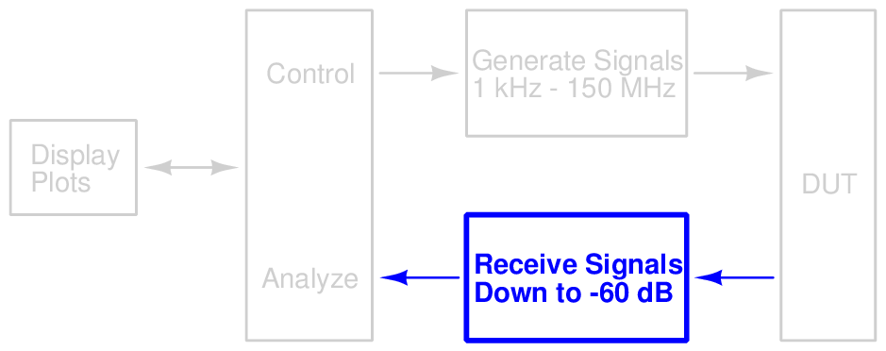
Design Detection
Notes:
K

Slide 13
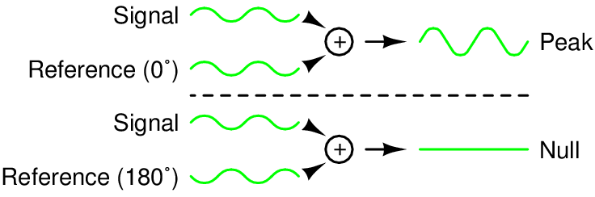
Design Phase Detection
Notes:
K

Slide 14
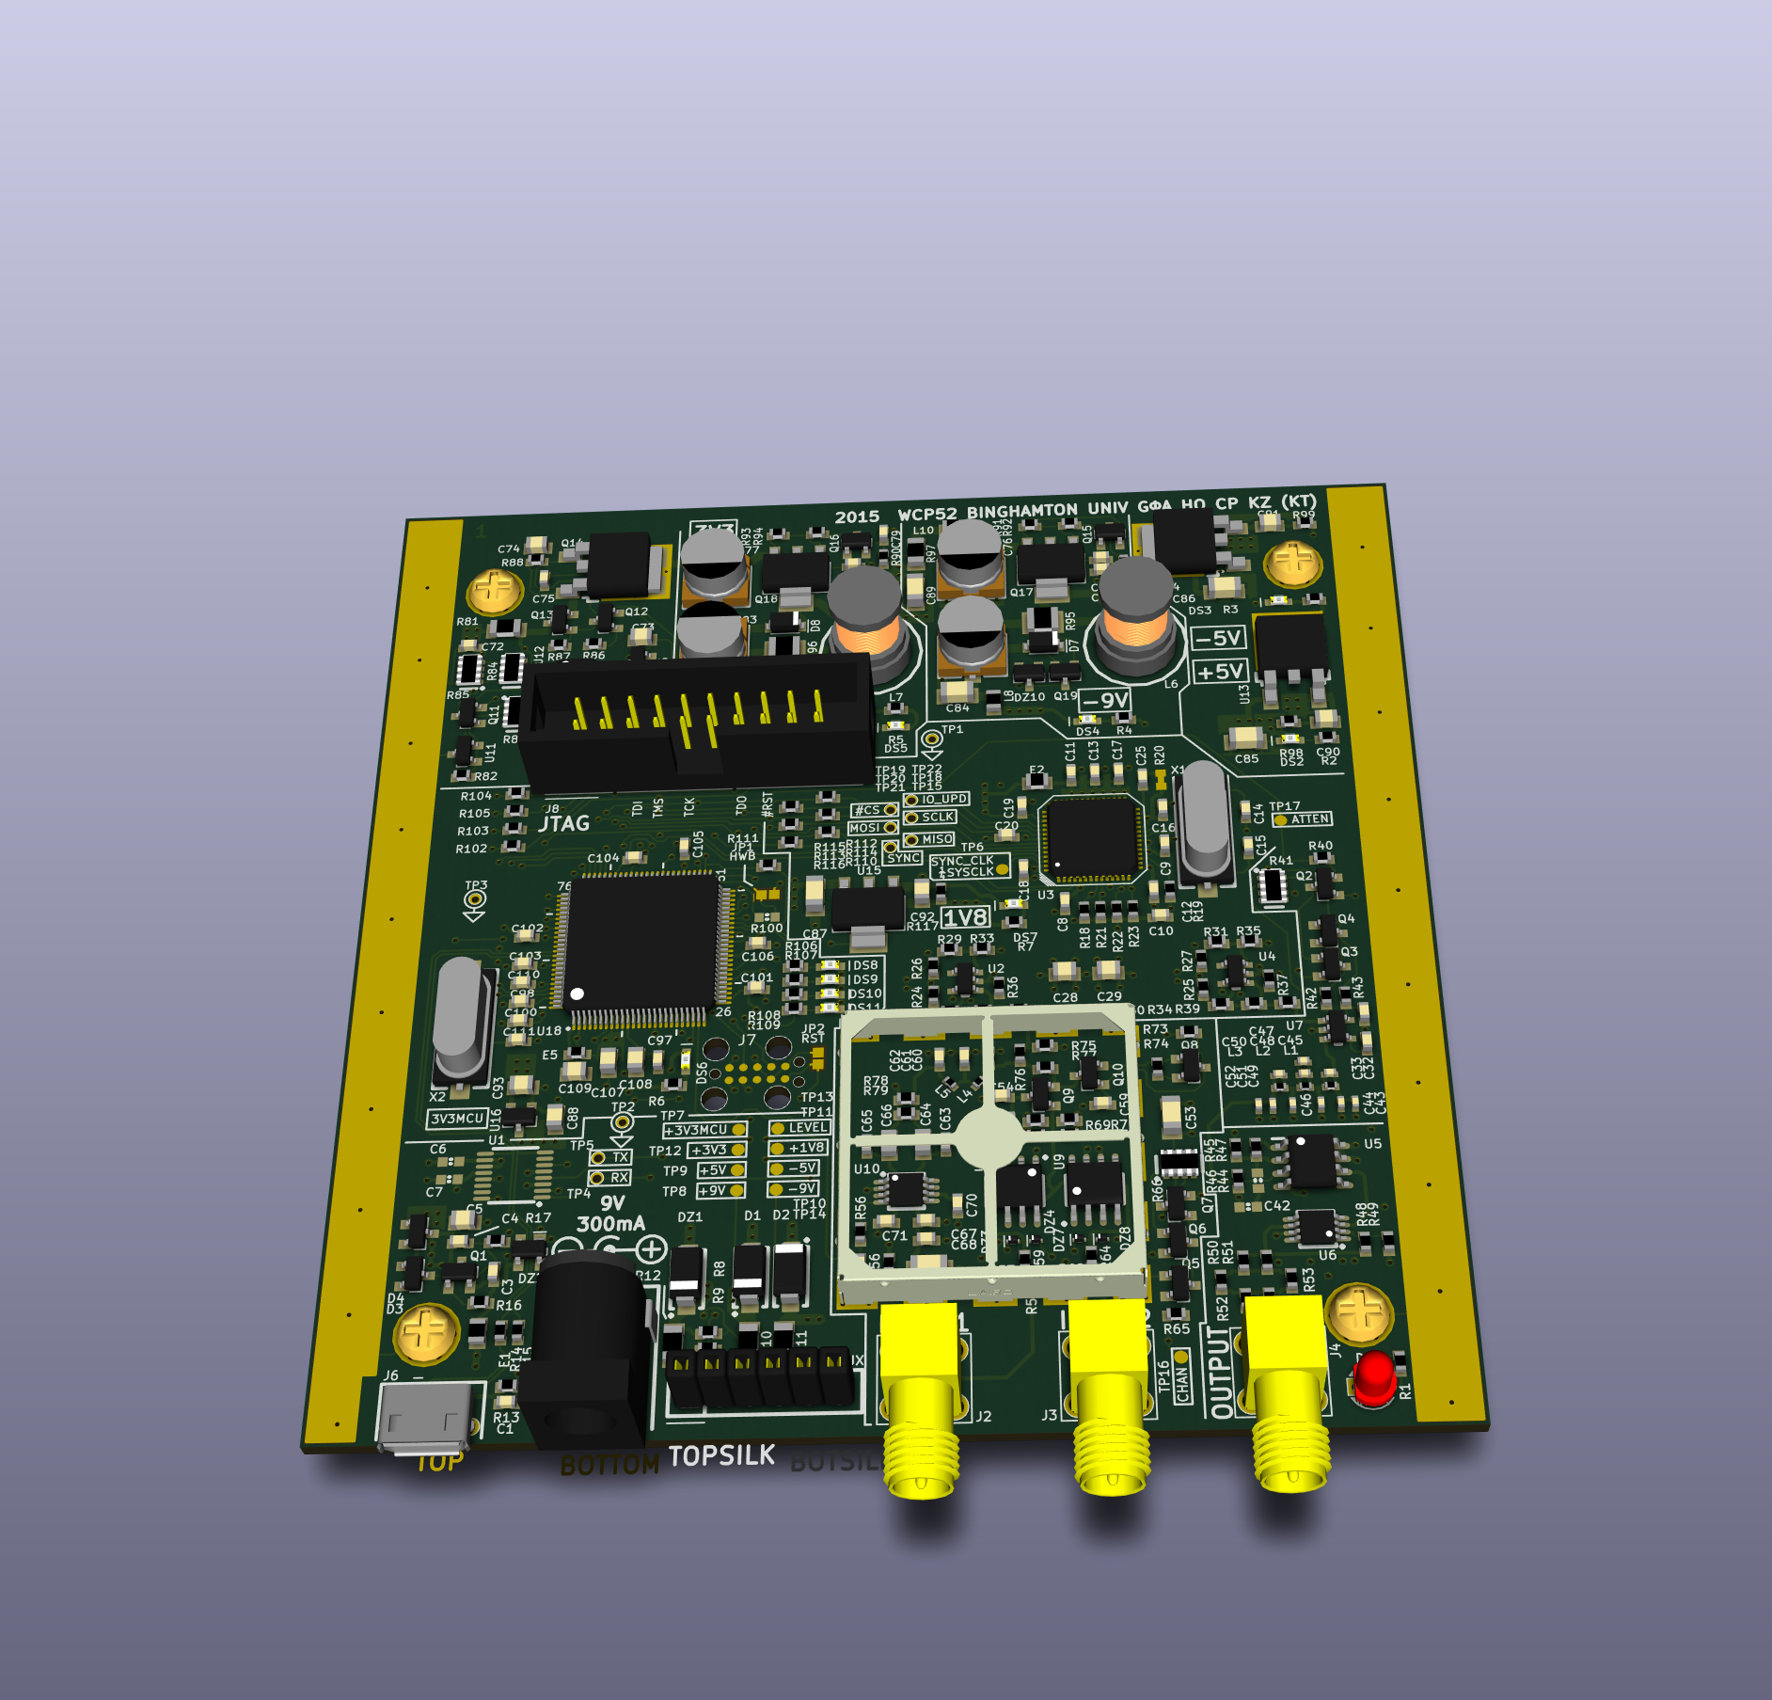
Design — PCB
Notes:
C

Slide 15
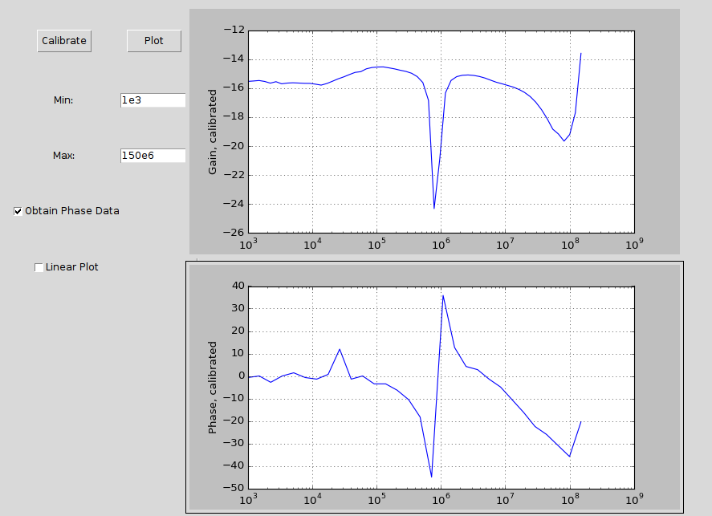
Design GUI
Notes:
Harrison

Slide 16
Schedule
Item | Completed
Specification | October 17, 2014
Development plan | October 31, 2014
Prototypes built | December 5, 2014
Interim | December 5, 2014
Prototypes corrected | February 26, 2015
Final PCB layout | March 14, 2015
Alpha firmware completed | March 19, 2015
PCB assembled | April 8, 2015
PC software completed | April 30, 2015
Notes:
Harrison

Slide 17
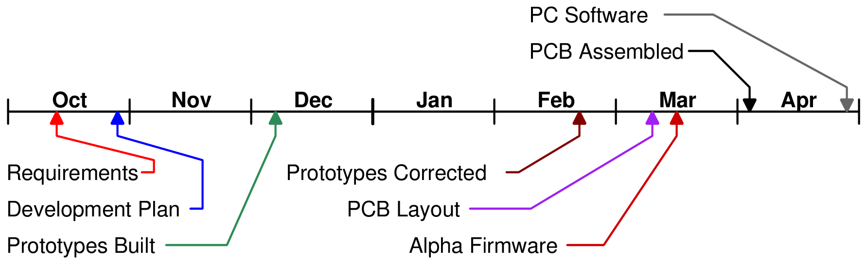
Timeline
Notes:
Harrison

Slide 18
Budget
Item | Expended | Actual | Est'd to Completion | Est'd at Completion
Synth. proto. | $60 | $60 | $0 | $60
Input proto. | $70 | $70 | $0 | $70
Amp proto. | $91 | $91 | $0 | $91
Final build | $210 | $210 | $0 | $210
Enclosure | $21 | $21 | $0 | $21
Total | $452 | $452 | $0 | $452
Notes:
Harrison

Slide 19
Future Plans
Hardware revision 2?
Remove parts to make board smaller
Less expensive power amplifier
Further software development
Integration with math packages
More robust algorithms
Otherwise, ready to package!
Notes:
Ken

Slide 20
Conclusion
Product can capture Bode plots
Uses signal synthesizer, output amplifier, input frontend, ADC, and microcontroller
Cross-platform, open-source PC software
All requirements met
Notes:
Kaidi

Slide 21
Demo

